Slide 1
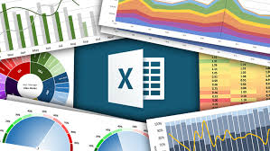
Excel charts and graphs for data presentations.

Slide 2
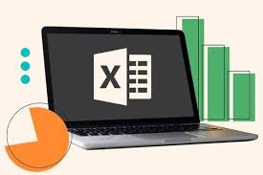
Introduction
Excel charts and graphs are visual representations of data from a Microsoft Excel worksheet that help users understand large amounts of data and the relationships between different data sets. They can be used to identify trends, make comparisons, and find patterns

Slide 3
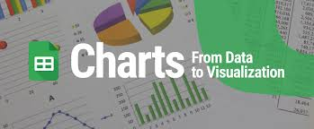
Steps to create a chart
Select data for the chart.
Select Insert > Recommended Charts.
Select a chart on the Recommended Charts tab, to preview the chart. ...
Select a chart.
Select OK.

Slide 4
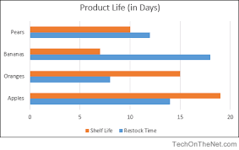
Bar chart
A simple chart to interpret that's good for comparing categorical data. The categorical data is on the y-axis, and the values are on the x-axis. Bar charts, or bar graphs, are a way to represent categorical data visually using rectangular bars. The height of each bar is proportional to the value it represents, and the bars are all the same width to make it easy to compare the data.

Slide 5
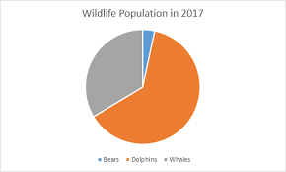
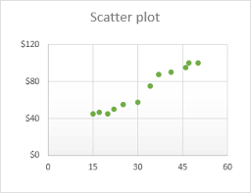
Pie chart
Pie charts are a useful tool for displaying basic statistical data in the shape of a circle. They are easy to read and can show a lot of information in a small space.
Scatter plot
A scatter plot (aka scatter chart, scatter graph) uses dots to represent values for two different numeric variables. The position of each dot on the horizontal and vertical axis indicates values for an individual data point.

Slide 6
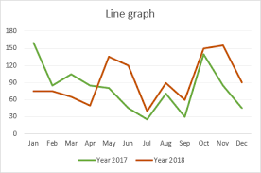
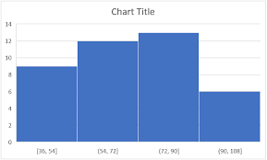
Line graph
It is a chart that shows a line joining several points or a line that shows the relation between the points. The graph represents quantitative data between two changing variables with a line or curve that joins a series of successive data points.
Histogram
The histogram is a popular graphing tool. It is used to summarize discrete or continuous data that are measured on an interval scale.

Slide 7
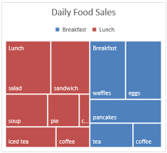
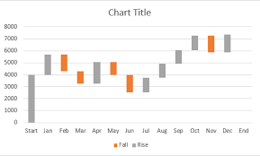
Tree map A tree map chart provides a hierarchical view of your data and makes it easy to spot patterns, such as which items are a store's best sellers. The tree branches are represented by rectangles and each sub-branch is shown as a smaller rectangle.
Waterfall chart
A waterfall chart shows a running total as values are added or subtracted. It's useful for understanding how an initial value (for example, net income) is affected by a series of positive and negative values.

Slide 8
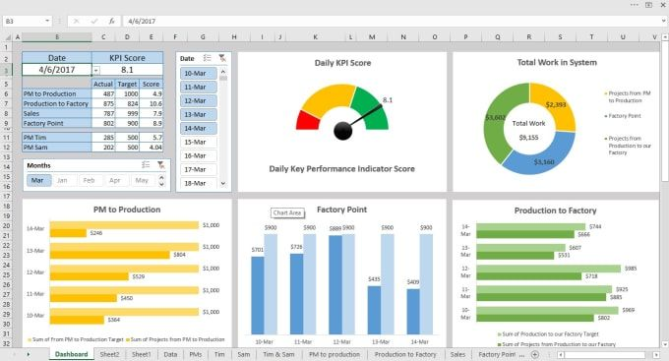
Visualization using pivot tables
1)Use PivotTables to create various data visualizations.
2) Charts like bar graphs and pie charts can be easily generated.
3) Visualizations help identify trends and patterns more easily.
4) PivotTables allow you to drill down into specific datapoints.
Steps to create visuals
1. Craft your visualization: Once you have arranged your fields in the PivotTable Fields pane, it's time to create the visual:○ Click anywhere within the PivotTable.○ Go to the "Insert" tab and select the desired chart type (e.g., Bar Chart, Pie Chart , Line Chart). Choose the chart that best conveys the relationships within your data.

Slide 9

2. Customize your visual:
Excel offers various formatting options to enhance your chart. You can:
○ Change chart type after creation.
○ Modify colors, fonts, and chart styles.
○ Add data labels and titles for clarity.
3. Fine-tune the PivotTable (optional):
You can further refine your analysis by:
○ Right-clicking on a specific data point in the PivotTable.
○ Selecting "Show Values" or "Show Values As % of Column Total" to gain deeperinsights.

Slide 10
Conclusion
In conclusion, Excel charts are essential for making data easier to understand. They turn complex numbers into clear visuals, helping users quickly spot trends and insights. By choosing the right chart type, anyone can communicate their findings more effectively, making data analysis straightforward and impactful. Overall, mastering these tools enhances our ability to present information clearly and supports better decision-making.

Slide 11
THANKYOU
If you have any questions?
thahliyamist@gmail.com

